Slide 1
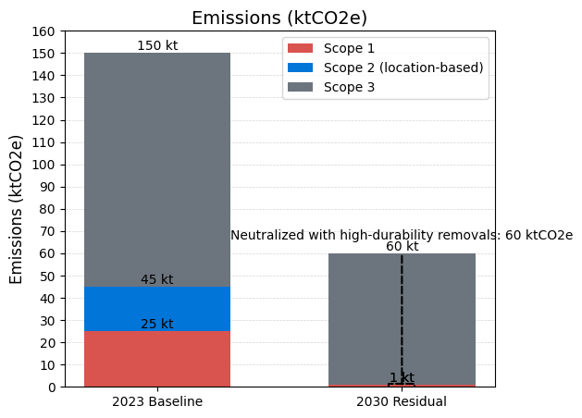
Baseline Emissions and 2030 Target
Baseline year: 2023
Totals ktCO2e:
Scope 1: 25
Scope 2 location based: 20
Scope 3: 105
Total: 150
Target 2030 post abatement ktCO2e:
Scope 1: 1
Scope 2 market based: 0
Scope 3: 59
Total: 60
Neutralization plan: Neutralize residual 60 ktCO2e in 2030 with high-durability removals (mineralization/BECCS).

